Slide 1


OpenShift – Presentation
Sridhar Akula

Slide 2
Agenda
OpenShift Overview
OpenShift Architecture
Infrastructure Components
Kubernetes Infrastructure
Container Registry
Web Console
3. Core Concepts
Containers & Images
PODS & Services
Projects & Users

Slide 3
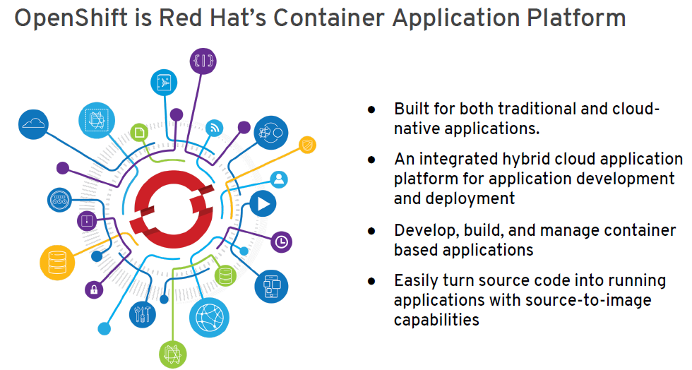

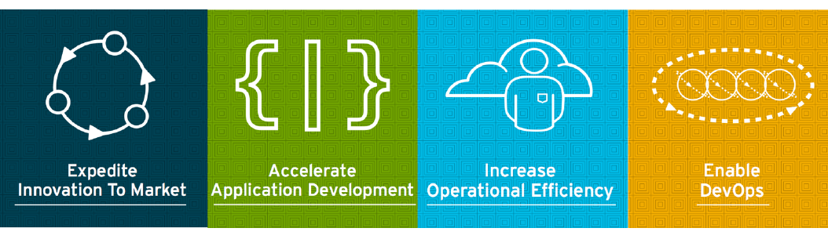
OpenShift Overview:
OpenShift Container Platform brings together Docker and Kubernetes, and provides an API to manage these services. OpenShift Container Platform allows us to create and manage containers.

Slide 4
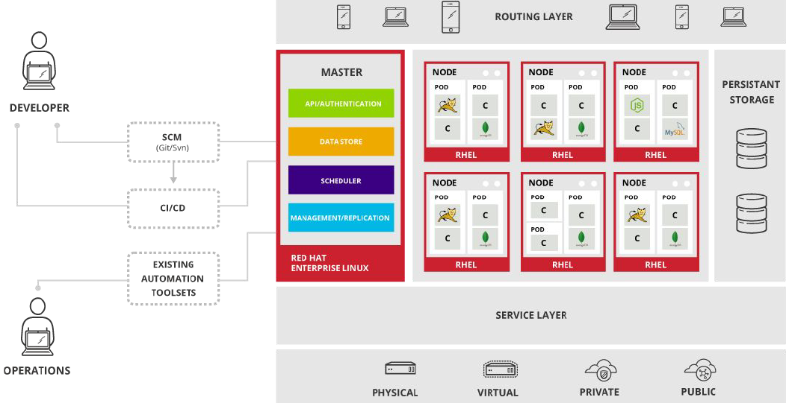
OpenShift Architecture:

Slide 5
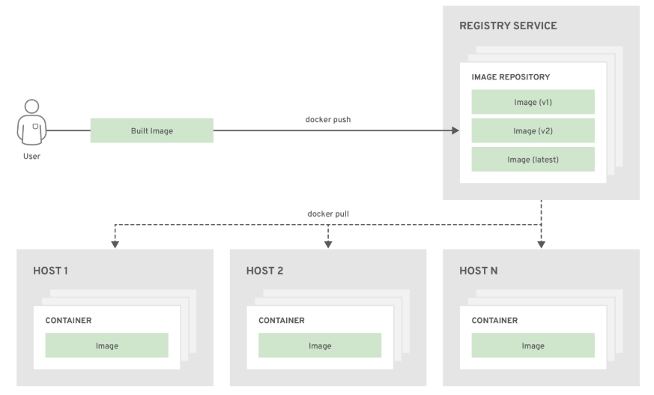
The relationship between containers, images, and registries is depicted in the following diagram:

Slide 6
Infrastructure Components:
Kubernetes Infrastructure: Within OpenShift Container Platform, Kubernetes manages containerized applications across a set of containers or hosts and provides mechanisms for deployment, maintenance, and application-scaling. The Docker service packages, instantiates, and runs containerized applications.
Container Registry: OpenShift Container Platform can utilize any server implementing the Docker registry API as a source of images, including the Docker Hub, private registries run by third parties, and the integrated OpenShift Container Platform registry.
Web Console: The OpenShift Container Platform web console is a user interface accessible from a web browser. Developers can use the web console to visualize, browse, and manage the contents of projects.

Slide 7
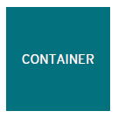
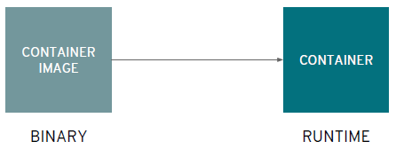
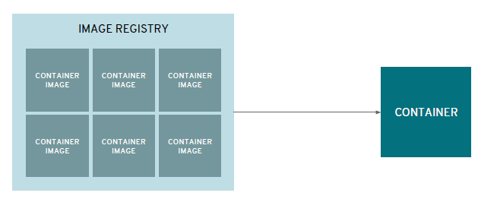
Core Concepts:
Containers: The basic units of OpenShift Container Platform applications are called containers. Linux container technologies are lightweight mechanisms for isolating running processes so that they are limited to interacting with only their designated resources.
Images: Containers in OpenShift Container Platform are based on Docker-formatted container images. An image is a binary that includes all of the requirements for running a single container, as well as metadata describing its needs and capabilities.
A container is the smallest compute unit. Containers are created from container images
Container images are stored in an image registry.
An image repository contains all versions of an
image in the image registry

Slide 8
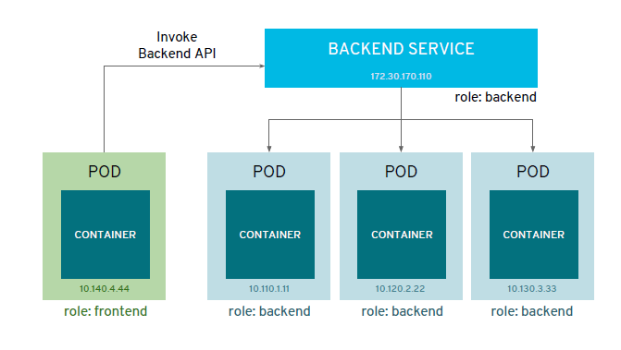
Core Concepts: Continuation …
PODS: OpenShift Container Platform leverages the Kubernetes concept of a pod, which is one or more containers deployed together on one host, and the smallest compute unit that can be defined, deployed, and managed.
Services: A Kubernetes service serves as an internal load balancer. It identifies a set of replicated pods in order to proxy the connections it receives to them.
Users: Interaction with OpenShift Container Platform is associated with a user. An OpenShift Container Platform user object represents an actor which may be granted permissions in the system by adding roles to them or to their groups.
Projects: A project is a Kubernetes namespace with additional annotations, and is the central vehicle by which access to resources for regular users is managed. A project allows a community of users to organize and manage their content in isolation from other communities.
Services provide internal load-balancing and service discovery across pods.
Apps can talk to each other via services.

Slide 9
Back up slides !

Slide 10
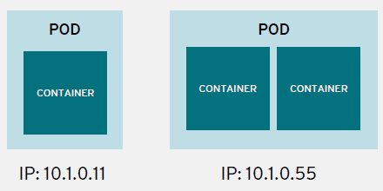
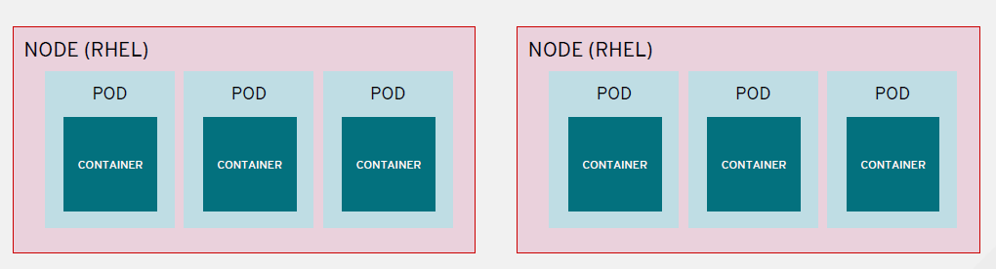
Containers: containers are wrapped in pods which are units of deployment and management, and share a common network address.
Pods are deployed to and run on nodes.

